Slide 1



Navigating Parental and Child Care Leave
I’m adopting or having a baby, what do I need to know?
Office of Human Resources

Slide 2
Who needs to be notified of your parental leave?
Office of Human Resources
Your supervisor
Employees are encouraged to inform their supervisor or department chair as soon as possible so planning can begin. HR should be notified at least 30 days before the anticipated leave start date.

Slide 3
Leave Program Overview
7-Month Childcare Leave
Family and Medical Leave Act (FMLA)
Paid Parental Leave (PPL)
Paid Family Leave (PFL)

Slide 4
7 Month Childcare Leave
Eligibility: All New York State employees
Duration: Up to 7 months of leave to care for or bond with a child
Payment: Employees must use accrued leave or apply for PFL/PPL if eligible

Slide 5
Family Medical Leave Act - FMLA
Eligibility: FSC employees who have worked at least 1,250 hours in the past year and have one year of state service.
Benefits: Provides up to 12 weeks of protected leave for the birth or adoption of a child.
Payment: Employees must use accrued leave.

Slide 6
What accruals can I charge?
Birth Parent:
  2-4 weeks before birth: Sick leave.
  6-8 weeks after birth: Sick leave.
  After disability period: Other available leave accruals.
Non-Delivering/Adopting Parent:
  UUP and MC employees: Up to 15 days of sick leave.
  Classified employees: Day of birth and up to one week following sick leave.
  Additional leave options if complications arise.

Slide 7
Paid Parental Leave - PPL
What is PPL? PPL is a protected leave of absence that allows employees to
remain in full pay status for up to 12 weeks with no charge to accruals
following the birth of a child or placement of a child for adoption or foster
care
Who is eligible for PPL? Any University employee who meets the eligibility
requirements
When would I use PPL? PPL can only be used continuously and must be used
within the first 7 months following the date of the birth, adoption or foster
care placement
All other benefits remain unchanged and available for use when applicable
Employees will not earn accruals or holidays while on PPL

Slide 8
PPL Eligibility Requirements
CSEA, PEF, NYSCOPBA & PBA of NYS
Eligible after 6 months of cumulative state service. Must be employed to work at least 50%
M/C
Eligible beginning of the first day of state employment. Must be employed to work at least 50%
UUP
Eligible after 6 months on the payroll. Must be employed to work at least 50%
FT academic employees must complete one semester on the payroll to be eligible
PT academic employees must complete at least one semester teaching 6 credits and must have been on the payroll teaching any number of credits during the semester immediately preceding the leave

Slide 9
Paid Family Leave - PFL
Who is eligible for PFL?
Currently only available for UUP and MC employees.
What is PFL?
PFL is a protected leave that allows pay for the employee from a separate insurance carrier.
When would I use PFL?
PFL can be used continuously or intermittently and is a great option for employees with limited accruals. PFL can be used within 1 year of the birth or adoption.
How do I get paid on PFL?
The employee will come off of the University’s payroll and will be paid directly from a separate insurance carrier. The use of accruals on the same day as claiming PFL is prohibited.

Slide 10
Paid Parental Leave vs. Paid Family Leave
Paid Parental Leave (PPL):
Employees paid at full pay (100%) with no charge to accruals
Available to all University employees who meet the eligibility requirements
Must be used within 7 months of the birth, adoption, or foster care placement
Must be used continuously
Paid Family Leave (PFL):
Employees paid at about 67% of normal salary by a separate insurance company. Accruals are not charged during PFL
Only available to UUP and M/C employees
Must be used within 1 year of the birth, adoption, or foster care placement
Can be used continuously or intermittently

Slide 11
How these Leaves work together?
FMLA runs simultaneously with PFL and/or PPL if absence qualifies
The 7-Month Childcare Leave will begin the date the child is born or adopted

Slide 12
Communicating with HR & Time Records
Submit leave request and proposed leave plan.
Keep records updated and provide birth/adoption proof.
Delivering parents must provide medical clearance to return

Slide 13
Leave Implications on Benefits
Health Insurance: Premiums must still be paid. On unpaid leave, full cost is the employee's responsibility ($1500–$2200/month for family). More at: https://www.cs.ny.gov/forms/ps431.pdf
Retirement: Contributions based on earnings. No contributions or service credit during unpaid leave.
Accruals & Holidays: Not earned during unpaid leave
Tenure/Appointment Timeline: May be affected—consult HR.

Slide 14
Adding a Newborn/Newly Adopted Child to Health Insurance
Submit form PS-404 within 30 days.
Required documents:
  Birth certificate
  Social Security number
  Adoption papers (if applicable)
  Statement of Dependence (if needed)

Slide 15


Dental & Vision Coverage
CSEA & UUP: Contact your union directly.
M/C, PEF, NYSCOPBA, PBANYS: Use PS-404 to elect coverage.

Slide 16
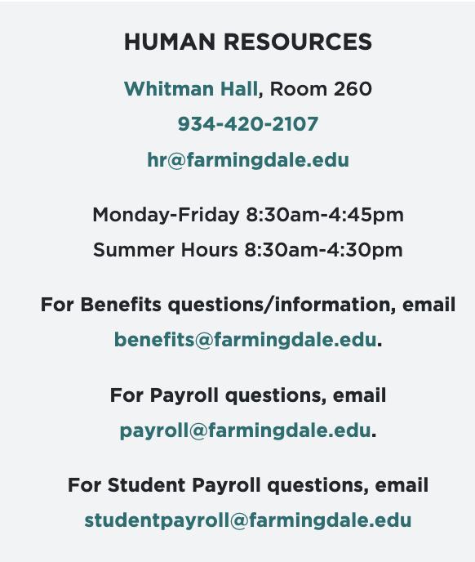
Contact Information
Office of Human Resources
Website: farmingdale.edu/human-resources/

