Slide 1
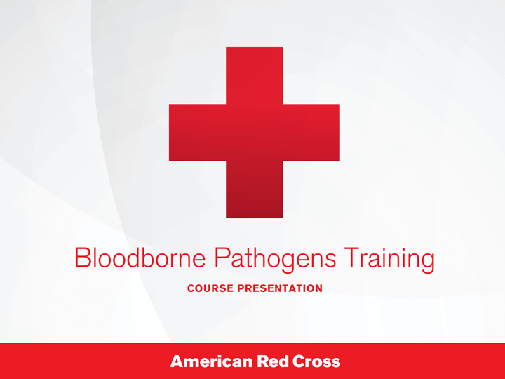
Bloodborne Pathogens Training, course presentation
Notes:
Bloodborne Pathogens Training, course presentation by the American Red Cross.

Slide 2
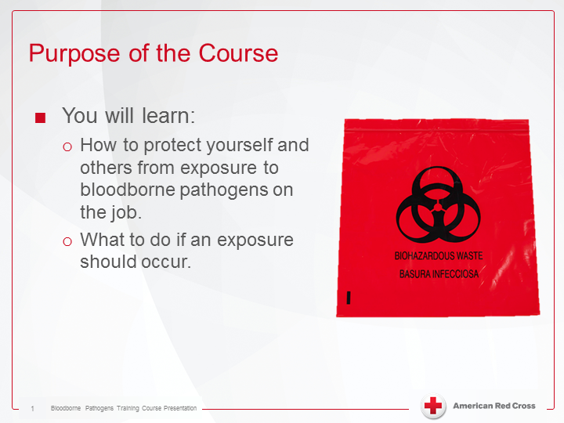
Purpose of the Course
Notes:
Purpose of the course
You will learn:
1. How to protect yourself and others from exposure to bloodborne pathogens on the job.
2. What to do if an exposure should occur.

Slide 3
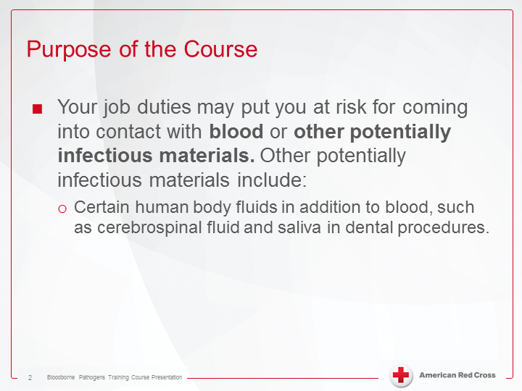
Purpose of the Course, continuation
Notes:
Purpose of the Couse:
- Your job duties may be put you at risk for coming into contact with blood or other potentially infectious materials. Other potentially infectious materials include:
Certain human body fluids in addition to blood, such as cerebrospinal fluid and saliva in dental procedures.

Slide 4
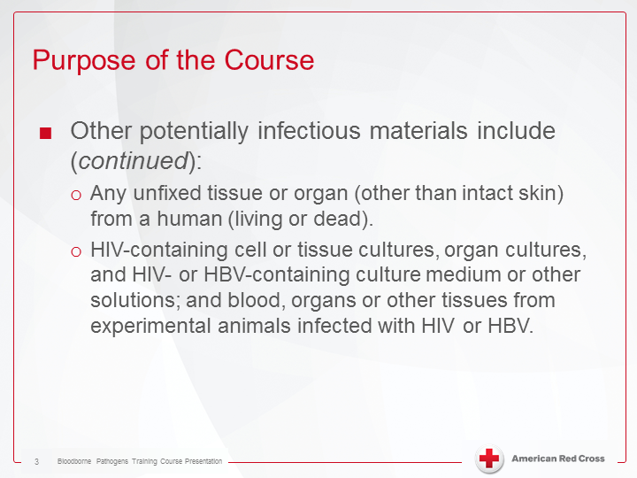
Purpose of the Course, 3
Notes:
Purpose of the Course:
- Other potentially infectious materials include (continued):
a) Any unfixed tissue or organ (other than intact skin) from a human (living or dead).
b) HIV-containing cell or tissue cultures, organ cultures, and HIV- or HBV-containing culture medium or other solutions; and blood, organs or other tissues from experimental animals infected with HIV or HBV.

Slide 5
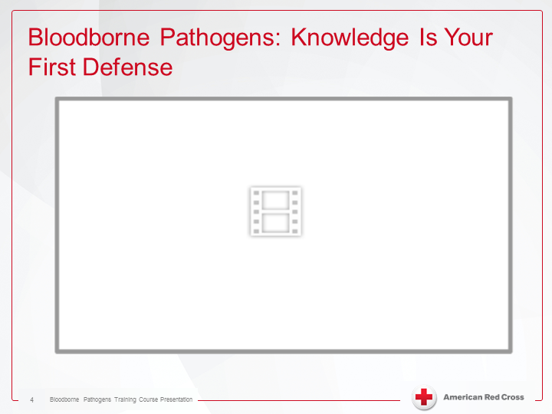

Bloodborne Pathogens: Knowledge is your first defense
Notes:
Bloodborne Pathogens: Knowledge is your first defense (click to play video).
Transcript:
Welcome to the American Red Cross Bloodborne Pathogens training course. Here, you’ll learn how to prevent disease transmission through blood and other potentially infectious material. Let’s begin with some background information. Bloodborne pathogens are disease causing microorganisms that are present in human blood and other potentially infectious materials. Bloodborne pathogens can spread when blood from an infected person enters the bloodstream of a person who is not infected. In the workplace, primary concerns are Hepatitis B virus, Hepatitis C virus, and HIV, because infection from any of these viruses can have serious, long-term effects on a person’s health. Despite the health effects, there is no way to tell if a person is carrying a bloodborne pathogen just by looking at him or her. In fact, an estimated 4.4 million Americans are living with chronic, viral hepatitis, and most do not even know that they are infected. Because of this, it is crucial to take appropriate preventative measures when handling blood or other potentially infectious material. People from many occupations may be at increased risk of exposure to bloodborne pathogens while at work. Fortunately, the Occupational Safety and Health Administration (OSHA) requires employers to take appropriate measures to protect at risk employees from on the job exposure to bloodborne pathogens, including training courses such as this one. However, the responsibility for lowering the risk for on the job exposure to bloodborne pathogens is not solely the responsibility of the employer. Employees must also take responsibility for their own health and safety. This course will give you the knowledge and skills you need to protect yourself and others from contracting a bloodborne disease on the job.

Slide 6
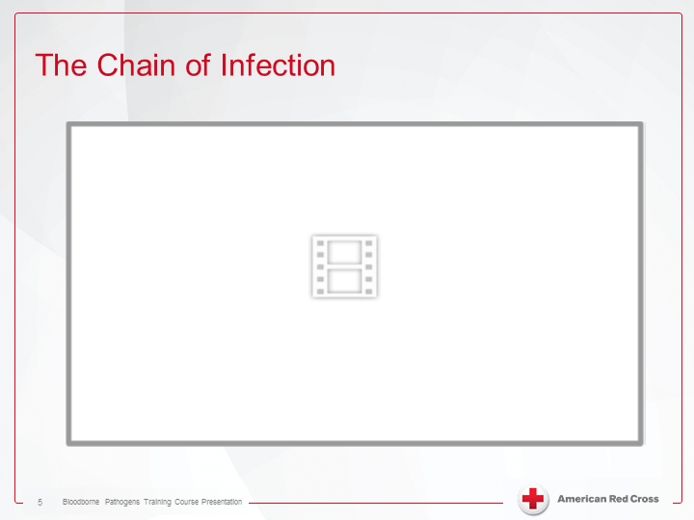

The chain of infection
Notes:
The chain of infection (play video).
Transcript:
We share the planet with millions of microorganisms, many of which cause us no harm, and some of which actually benefit us. However, some microorganisms, called pathogens, are capable of causing disease. Our bodies are equipped with many natural defenses against infection causing pathogens. Healthy, intact skin and mucous membranes help to prevent pathogens from entering the body. Areas of broken skin, like a cut or rash, could allow germs to enter. When this happens, we depend on our white blood cells which patrol the body and destroy pathogens that may enter. In addition to our natural defenses, antibiotics and vaccinations are also available to help us fight and prevent infection. However, while these defenses are helpful, infectious diseases are still common. You can better help yourself by understanding how infections are spread. For infections to occur, six requirements must be met – this is called the “chain of infection.” The first requirement is a pathogen. For an infection to occur, a microorganism capable of causing disease must be present. A pathogen will require a reservoir, or a place where pathogens can grow and multiply. Possible reservoirs for pathogens include human bodies, animals, insects, bodies of water, and food. Once the pathogens have multiplied sufficiently, they must have a way of leaving the reservoir – this is called a “portal of exit” and varies depending on the pathogen and the reservoir. When the reservoir is a human body, for example, the portal of exit may be the respiratory tract, the digestive tract, the reproductive and urinary tract, or, breaks in the skin. To get to another person, a pathogen will require a “method of transmission,” which can be direct or indirect. Direct transmission means the pathogen is passed from one person to another through physical contact. Indirect transmission means that pathogens are spread by way of a contaminated surface, or object. To complete the transmission, the pathogen must find a “portal of entry.” Just as the pathogen must have a way of leaving the reservoir, it must also have a way of gaining entry into a new reservoir. In the case of person to person transmission, potential portals of entry include the respiratory tract, the digestive tract, the reproductive and urinary tract, the eyes, and breaks in the skin. Finally, the pathogen must enter a “susceptible host,” or a person who is capable of becoming infected with that particular pathogen. Eliminating just one link in the chain can prevent an infection from spreading.

Slide 7
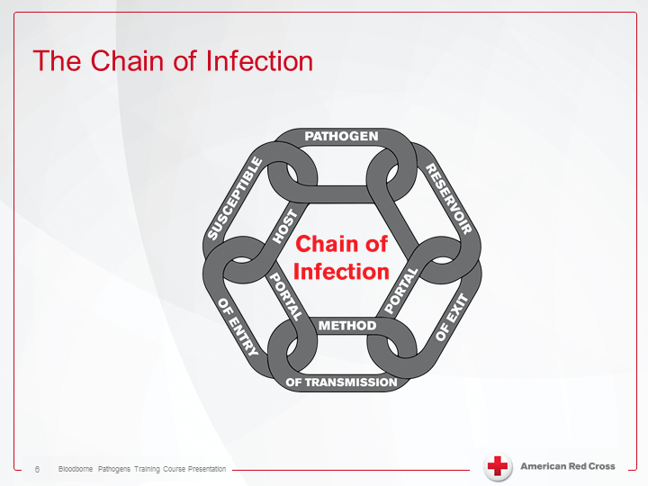
The Chain of Infection
Notes:
The Chain of Infection: Susceptible host; pathogen; reservoir; portal of exit; method of transmission; portal of entry; all interlinked.

Slide 8
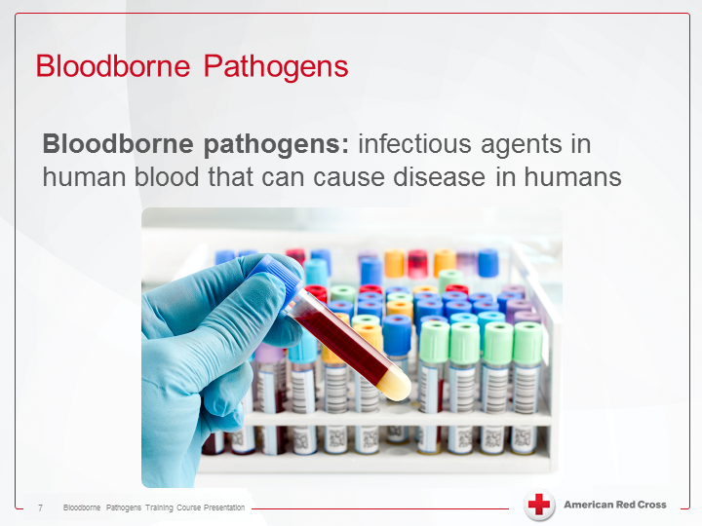
Bloodborne Pathogens
Notes:
Bloodborne Pathogens:
Bloodborne pathogens: Infectious agents in human blood that can cause disease in humans.

Slide 9
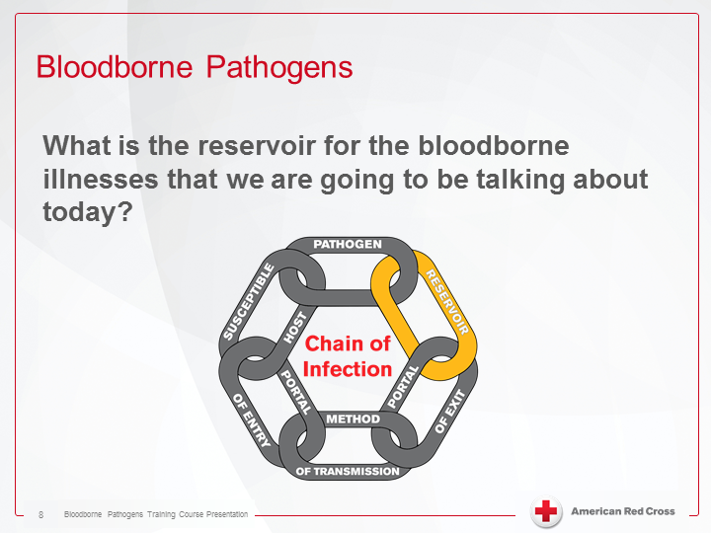
Bloodborne Pathogens 2
Notes:
Bloodborne Pathogens:
What is the reservoir for the bloodborne illnesses that we are going to be talking about today?

Slide 10
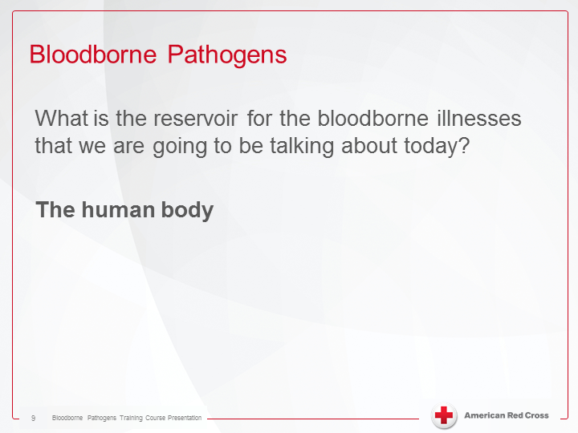
Bloodborne Pathogens
Notes:
Bloodborne Pathogens: What is the reservoir for the bloodborne illnesses that we are going to be talking about today?
The human body

Slide 11
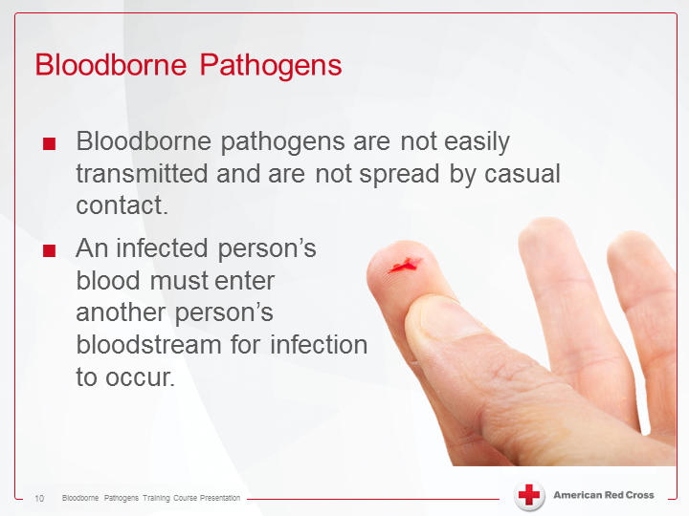
Bloodborne Pathogens 3
Notes:
Bloodborne Pathogens:
- Bloodborne pathogens are not easily transmitted and are not spread by casual contact.
- An infected person's blood must enter another person's bloodstream for infection to occur.

Slide 12
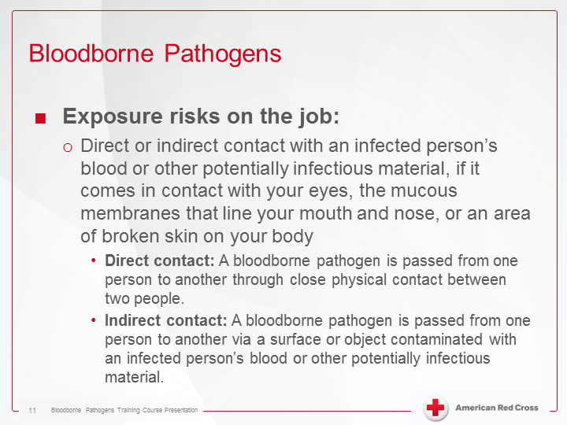
Bloodborne Pathogens 4
Notes:
Bloodborne Pathogens:
- Exposure risks on the job:
1) Direct or indirect contact with an infected person's blood or other potentially infectious material, if it comes in contact with your eyes, the mucous membranes that line your mouth and nose, or an area or broken skin on your body.
A) Direct contact: A bloodborne pathogen is passed from one person to another through close physical contact between two people.
B) Indirect contact: A bloodborne pathogen is passed from one person to another via a surface or object contaminated with an infected person's blood or other potentially infectious material.

Slide 13
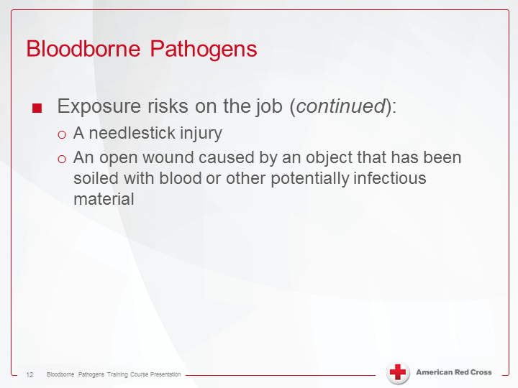
Bloodborne Pathogens 5
Notes:
Bloodborne Pathogens:
- Exposure risks on the job (continued):
a) A needlestick injury.
B) An open wound caused by an object that has been soiled with blood or other potentially infectious material.

Slide 14
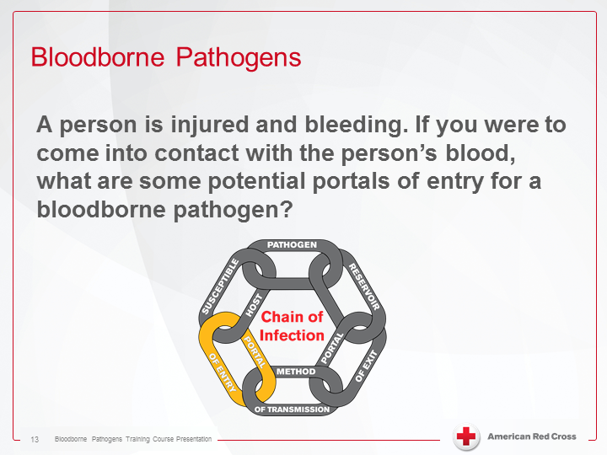
Bloodborne Pathogens 6
Notes:
Bloodborne Pathogens:
A person is injured and bleeding. If you were to come in contact with the person's blood, what are some potential portals of entry for a bloodborne pathogen?

Slide 15
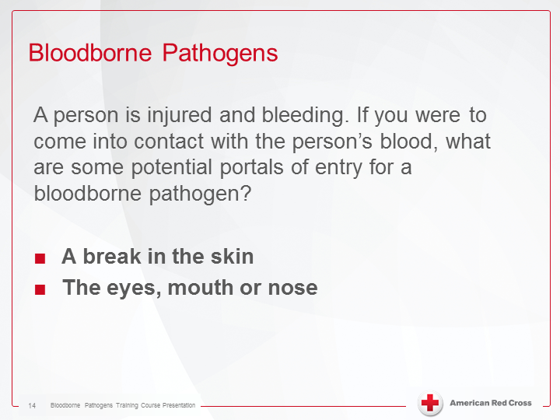
Bloodborne Pathogens 7
Notes:
Bloodborne Pathogens:
A person is injured and bleeding. If you were to come into contact with the person's blood, what are some of the potential portals of entry for a bloodborne pathogen?
- A break in the skin.
- The eyes, mouth or nose.

Slide 16
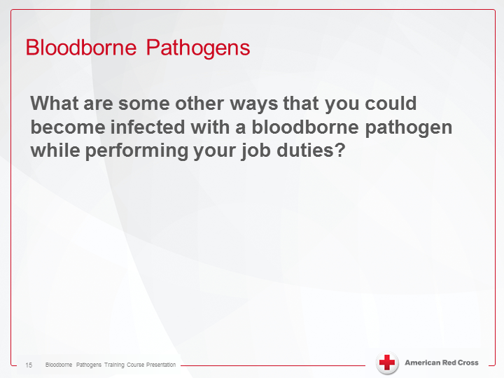
Bloodborne Pathogens 8
Notes:
Bloodborne Pathogens:
What are some other ways that you could become infected with a bloodborne pathogen while performing your job duties?

Slide 17
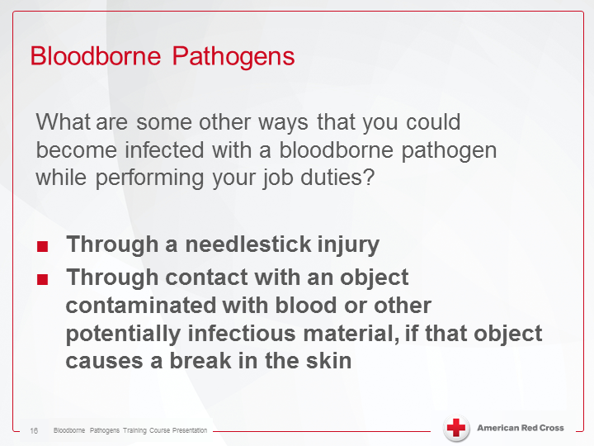
Bloodborne Pathogens 9
Notes:
Bloodborne Pathogens:
What are some other ways that you could become infected with a bloodborne pathogen while performing your job duties?
- Through a needlestick injury.
- Through contact with an object contaminated with blood or other potentially infectious material, if that object causes a break in the skin.

Slide 18
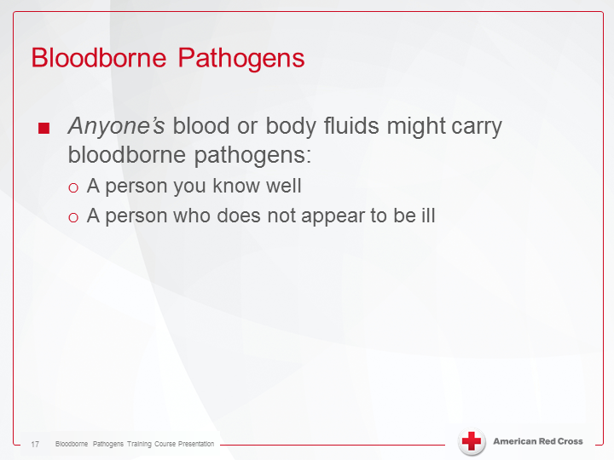
Bloodborne pathogens 10
Notes:
Bloodborne Pathogens:
- Anyone's blood or body fluids might carry bloodborne pathogens:
A) A person you know well.
B) A person who does not appear to be ill.

Slide 19
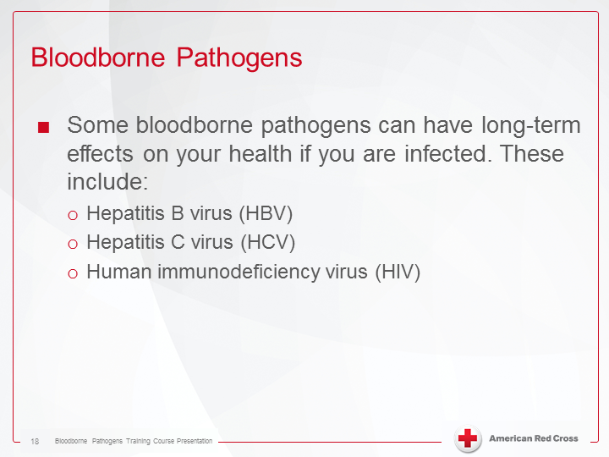
Bloodborne pathogens 11
Notes:
Bloodborne Pathogens:
- Some bloodborne pathogens can have long-term effects on your health if you are infected. These include:
A) Hepatitis B virus (HBV).
B) Hepatitis C virus (HBV)
C) Human immunodeficiency virus (HIV).

Slide 20
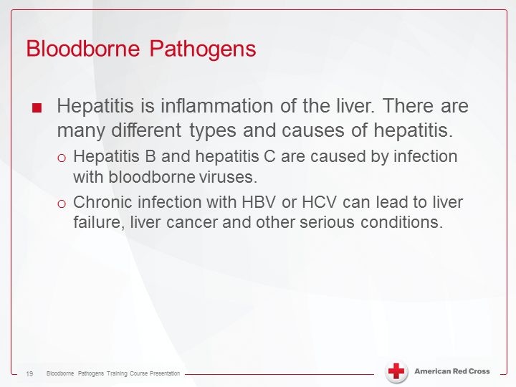
Bloodborne pathogens
Notes:
Bloodborne Pathogens:
- Hepatitis is inflammation of the liver. There are many different types and causes of hepatitis.
A) Hepatitis B and hepatitis C are cause by infection with bloodborne viruses.
B) Chronic infection with HBV or HCV can lead to liver failure, liver cancer and other serious conditions.

Slide 21
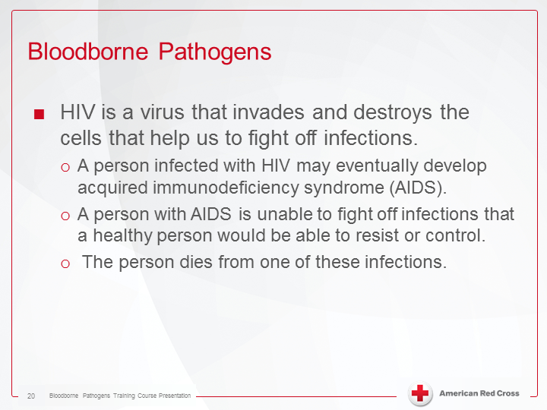
Bloodborne pathogens 12
Notes:
Bloodborne Pathogens:- HIV is a virus that invades and destroys the cells that help us to fight off infections.
A) A person infected with HIV may eventually develop acquired immunodeficiency syndrome (AIDS).
B) A person with AIDS is unable to fight off infections that a healthy person could be able to resist or control.
C) The person dies from one of these infections.

Slide 22
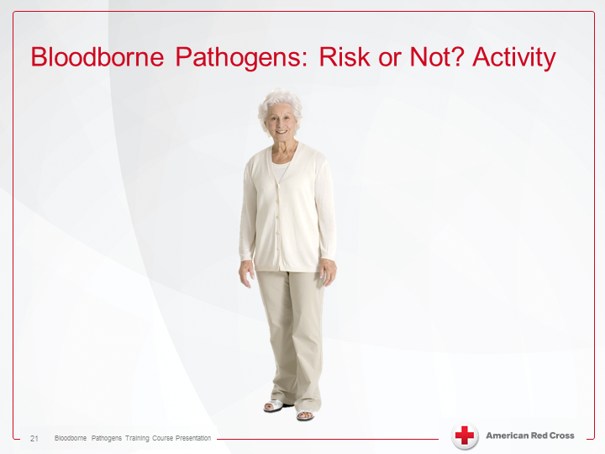
Bloodborne pathogens: Risk or Not? Activity
Notes:
Bloodborne Pathogens: Risk or Not? Activity

Slide 23
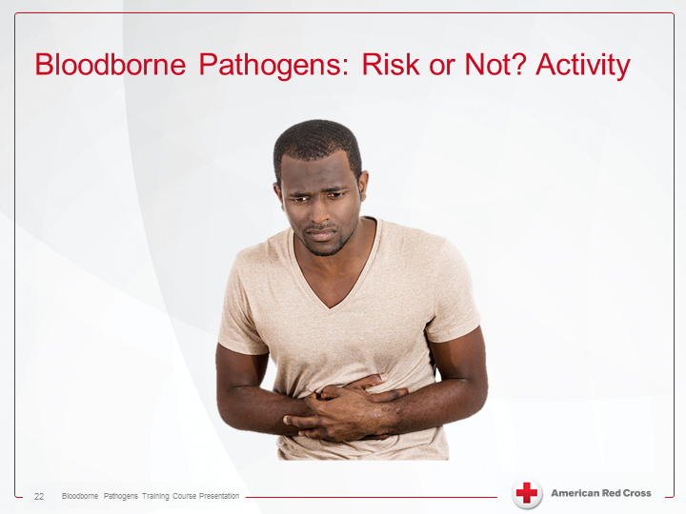
Bloodborne pathogens: Risk or Not? Activity
Notes:
Bloodborne Pathogens: Risk or Not? Activity

Slide 24
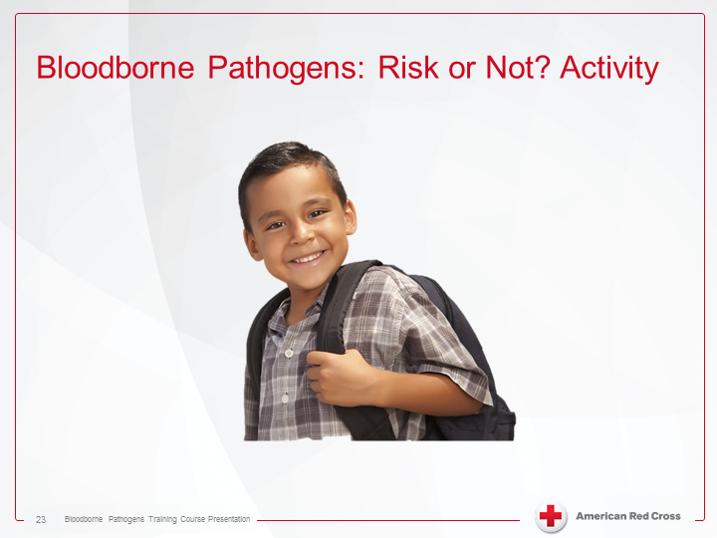
Bloodborne pathogens: Risk or Not? Activity
Notes:
Bloodborne Pathogens: Risk or Not? Activity

Slide 25
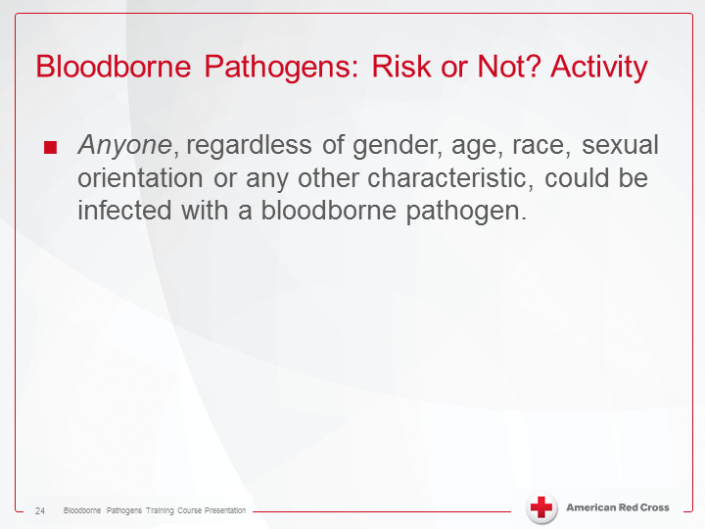
Bloodborne pathogens: Risk or Not? Activity
Notes:
Bloodborne Pathogens: Risk or Not? Activity
- Anyone, regardless of gender, age, race, sexual orientation or any other characteristic, could be infected with a bloodborne pathogen.

Slide 26
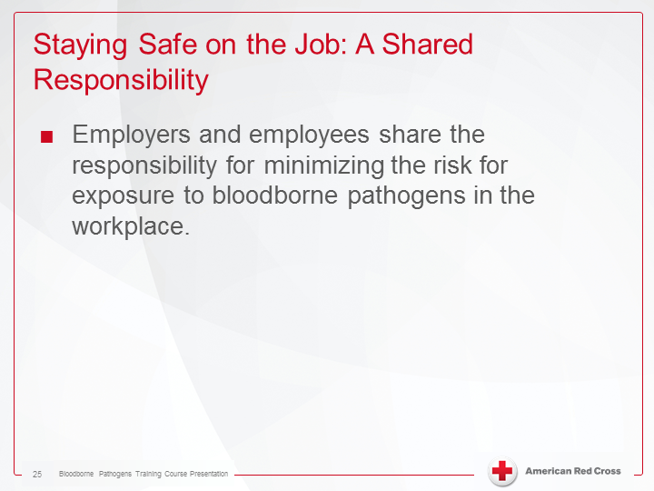
Staying safe on the job: A shared responsibility
Notes:
Staying safe on the job: A shared responsibility:
- Enployers and employees share the responsibility for minimizing the risk for exposure to bloodborne pathogens in the workplace.

Slide 27

Staying safe on the job: A shared responsibility
Notes:
Staying safe on the job: A shared responsibility (play video).
Transcript:
Employers, and employees, share the responsibility for minimizing the exposure to bloodborne pathogens. To protect workers, employers are required to adhere to the OSHA bloodborne pathogens standard. OSHA requires employers to maintain a written exposure control plan. This plan outlines the protective actions that will be taken to eliminate, or minimize, occupation exposure to blood or other potentially infectious materials. It also describes procedures that will be taken if an on the job exposure occurs. Engineering and work practice controls are identified in the exposure control plan. Engineering controls are tools that employees can use to protect themselves and others from exposure. These include personal protective equipment, biohazard waste bags, and biohazard sharps containers. Work practice controls are procedures employees should follow to protect themselves and others from exposure. These include the use of PPE, disposal of contaminated materials, safe handling of sharps, and proper cleaning of equipment. In addition to establishing an exposure control plan, employers must provide proper training about risks associated with bloodborne pathogens, and, to minimize these risks to all employees who may be exposed to bloodborne pathogens. Employers must also offer a Hepatitis B vaccination to employees who are at risk of exposure. An employee may refuse the vaccination, but if later decides to accept the vaccination, the employer must provide it. As an employee, you should know and follow your employer’s exposure control plan. Make sure to use the tools your employer provides and follow the procedures your employer has established to help keep you safe. It is especially important that you use standard precautions and treat all blood and other potentially infectious materials as if they are known to contain bloodborne pathogens.

Slide 28
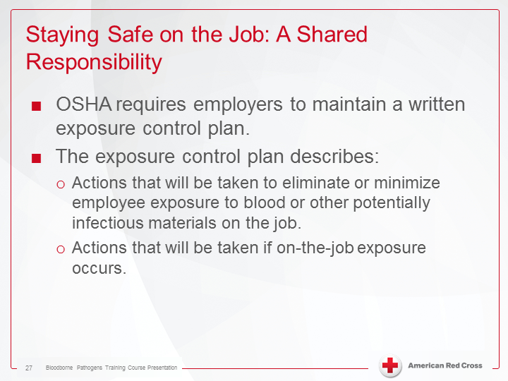
Staying safe on the job: A shared responsibility
Notes:
Staying safe on the job: A shared responsibility:
- OSHA requires employees to maintain a written exposure control plan.
- The exposure control plan describes:
A) Actions that will be taken to eliminate or minimize employee exposure to blood or other potentially infectious materials on the job.
B) Actions that will be taken if on-the-job exposure occurs.

Slide 29
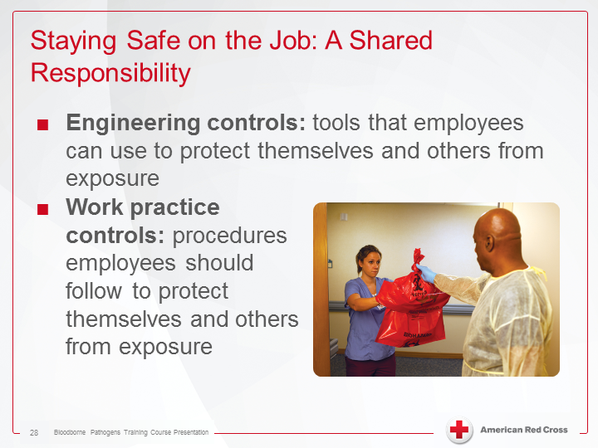
Staying safe on the job: A shared responsibility
Notes:
Staying safe on the job: A shared responsibility:
- Engineering controls: tools that employees can use to protect themselves and others from exposure.
- Work practice controls: procedures employees should follow to protect themselves and others from exposure.

Slide 30
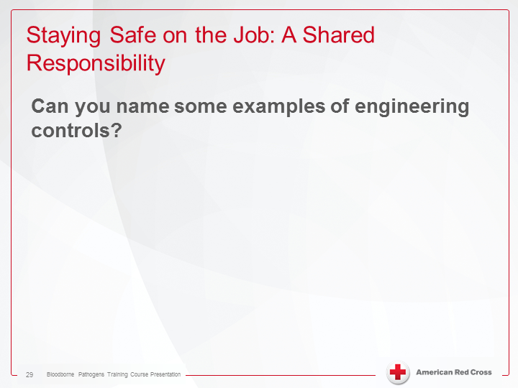
Staying safe on the job: A shared responsibility
Notes:
Staying safe on the job: A shared responsibility:
Can you name some examples of engineering controls?

Slide 31
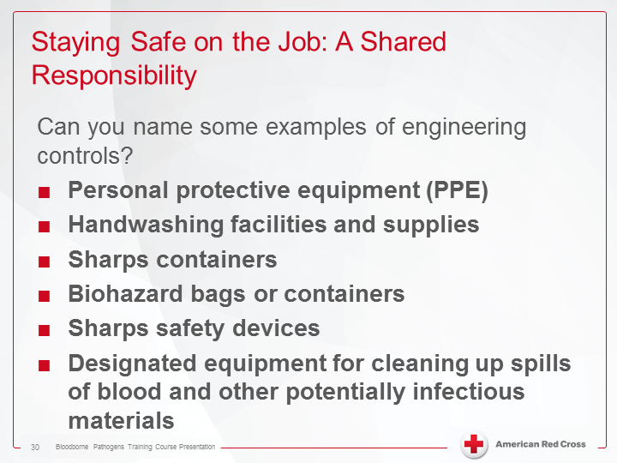
Staying safe on the job: A shared responsibility
Notes:
Staying safe on the job: A shared responsibility.
Can you name some examples of engineering controls?
- Personal protective equipment (PPE)
- Handwashing facilities and supplies sharp containers.
- Sharp containers.
- Biohazard bags or containers.
- Sharps safety devices.
- Designated equipment for cleaning up spills of blood and other potentially infectious materials.

Slide 32
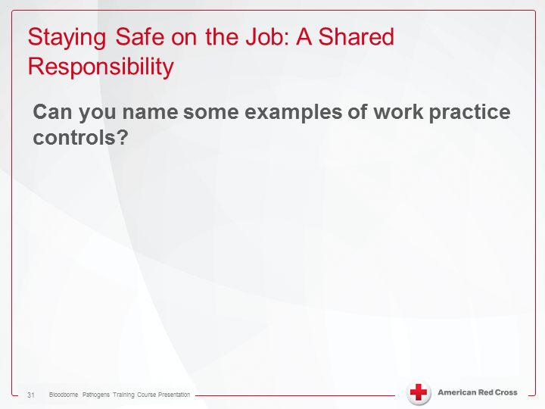
Staying safe on the job: A shared responsibility
Notes:
Staying safe on the job: A shared responsibility.
Can you name some examples of engineering controls?

Slide 33
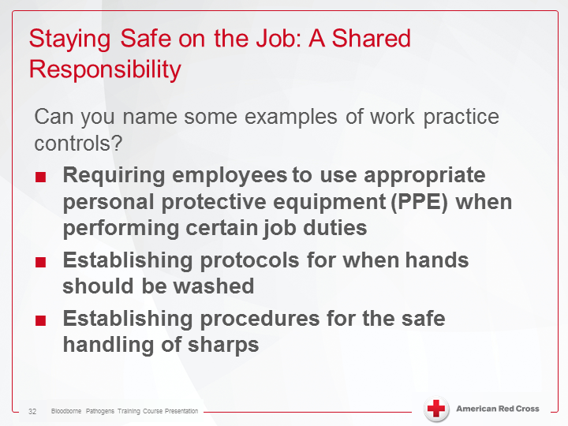
Staying safe on the job: A shared responsibility
Notes:
Staying safe on the job: A shared responsibility.
Can you name some examples of engineering controls?
- Requiring employees to use appropriate personal protective equipment (PPE) when performing certain job duties.
- Establishing protocols for when hands should be washed.
- Establishing procedures for the safe handling of sharps.

Slide 34
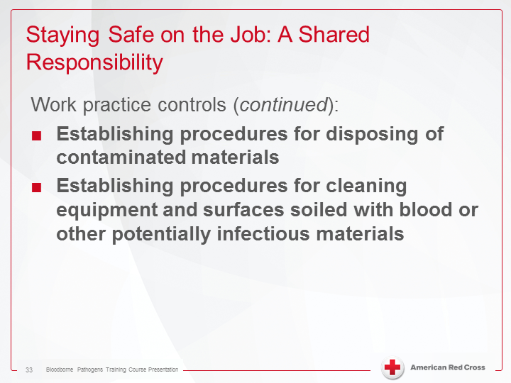
Staying safe on the job: A shared responsibility
Notes:
Staying safe on the job: A shared responsibility.
Work practice controls (continued):
Establishing procedures for disposing of contaminated materials
Establishing procedures for cleaning equipment and surfaces soiled with blood or other potentially infectious materials

Slide 35
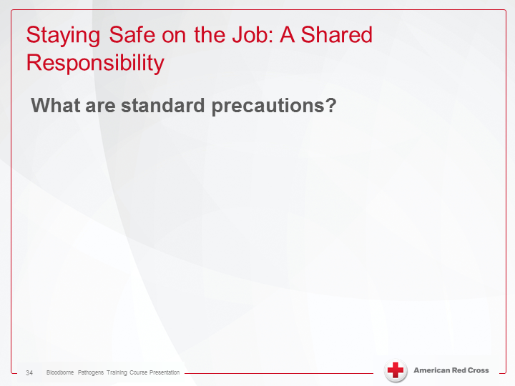
Staying safe on the job: A shared responsibility
Notes:
Staying Safe on the Job: A Shared Responsibility
What are standard precautions?

Slide 36
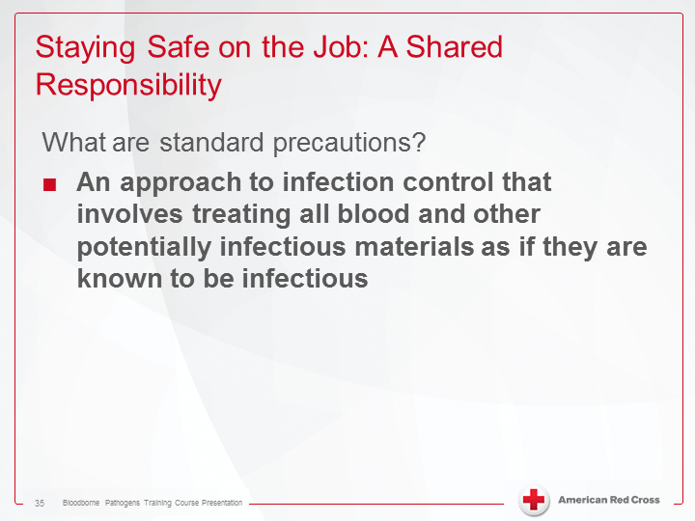
Staying safe on the job: A shared responsibility
Notes:
Staying safe on the job: A shared responsibility
What are standard precautions?
- An approach to infection control that involves treating all blood and other potentially infectious materials as if they were known to be infectious

Slide 37
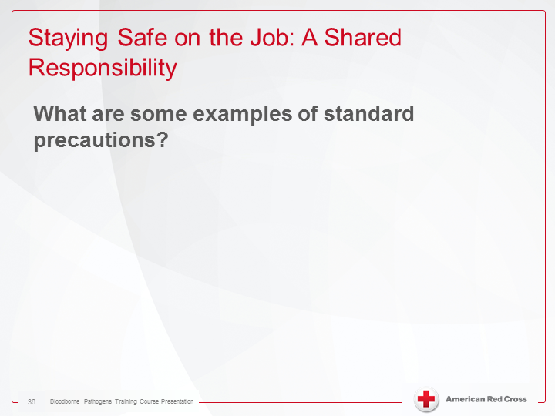
Staying safe on the job: A shared responsibility
Notes:
Staying safe on the job: A shared responsibility
What are some examples of standard precautions?

Slide 38
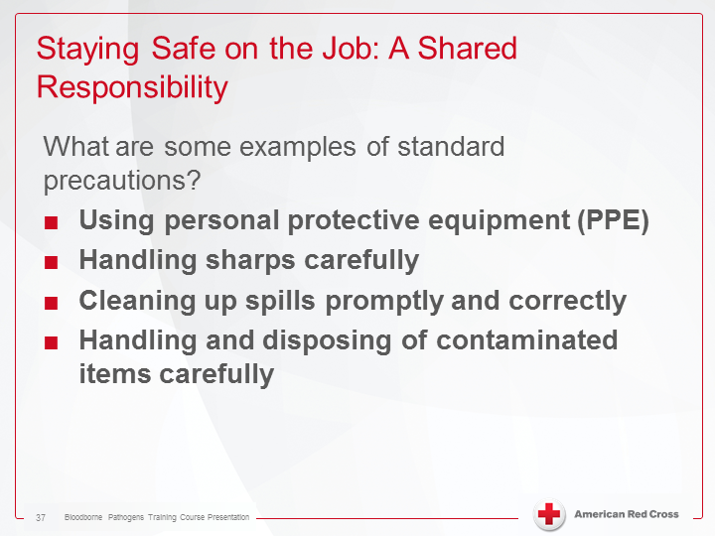
Staying safe on the job: A shared responsibility
Notes:
Staying safe on the job: A shared responsibility
What are some examples of standard precautions?
Using personal protective equipment (PPE)
Handling sharps carefully
Cleaning up spills promptly and correctly
Handling and disposing of contaminated items carefully

Slide 39
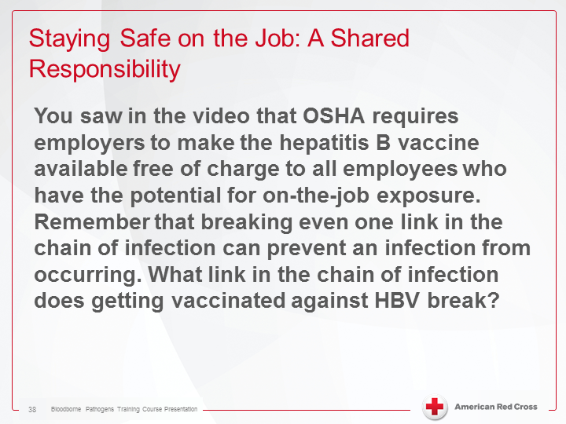
Staying safe on the job: A shared responsibility
Notes:
Staying safe on the job: A shared responsibility
You saw in the video that OSHA requires employers to make the hepatitis B vaccine available free of charge to all employees who have the potential for on-job exposure. Remember that breaking even one link in the chain of infection can prevent an infection from occurring. What link in the chain of infection does getting vaccinated against HBV break?

Slide 40
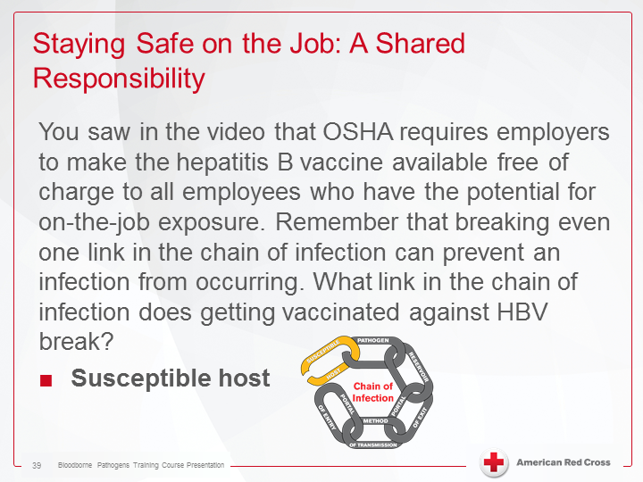
Staying safe on the job: A shared responsibility
Notes:
Staying safe on the job: A shared responsibility
You saw in the video that OSHA requires employers to make the hepatitis B vaccine available free of charge to all employees who have the potential for on-job exposure. Remember that breaking even one link in the chain of infection can prevent an infection from occurring. What link in the chain of infection does getting vaccinated against HBV break?
Susceptible host

Slide 41
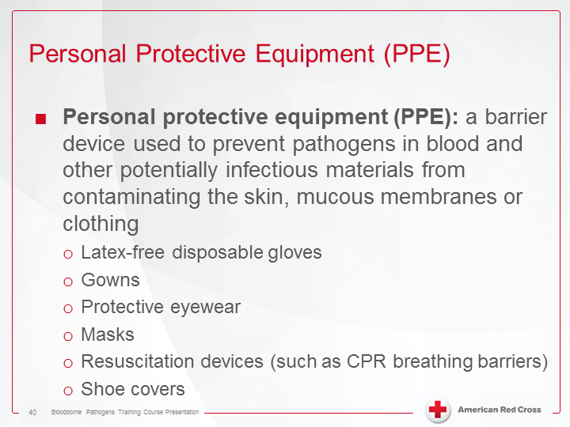
Personal Protective Equipment (PPE)
Notes:
Personal Protective Equipment (PPE)
Personal protective equipment (PPE): a barrier device used to prevent pathogens in blood and other potentially infectious materials from contaminating the skin, mucous membranes or clothing.
Latex-free disposable gloves
Gowns
Protective eyewear
Masks
Resuscitation devices (such as CPR breathing barriers)
Shoe covers

Slide 42
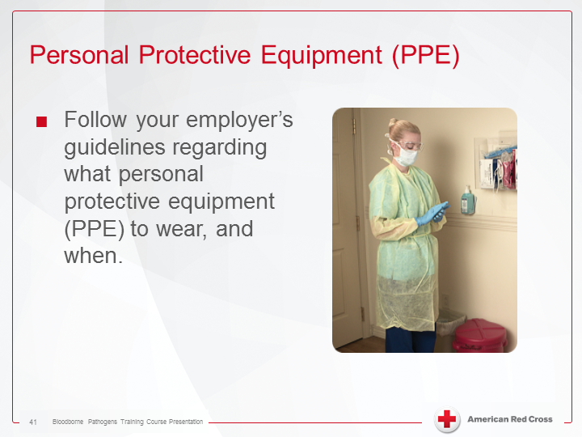
Personal Protective Equipment (PPE)
Notes:
Personal Protective Equipment (PPE)
Follow your employer’s guidelines regarding what personal equipment (PPE) to wear, and when.

Slide 43
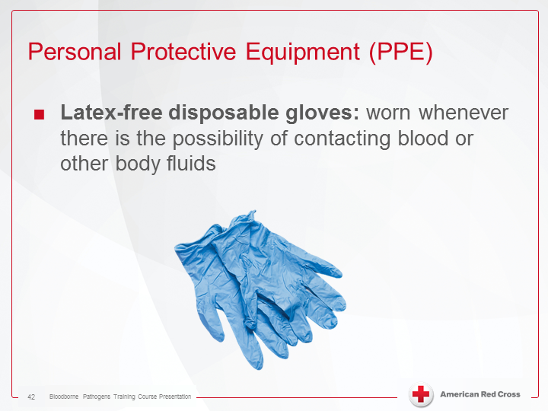
Personal Protective Equipment (PPE)
Notes:
Personal Protective Equipment (PPE)
Latex-free disposable gloves: worn whenever there is the possibility of contacting blood or other bodily fluids

Slide 44
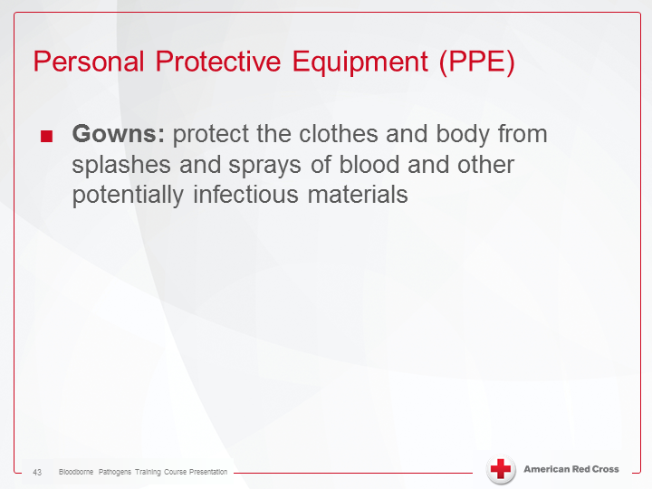
Personal Protective Equipment (PPE)
Notes:
Personal Protective Equipment (PPE)
Gowns: protect the clothes and body from splashes and sprays of blood and other potentially infectious materials

Slide 45
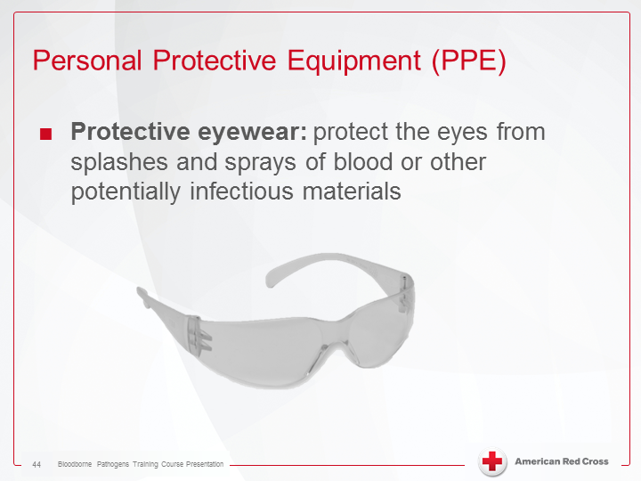
Personal Protective Equipment (PPE)
Notes:
Personal Protective Equipment (PPE)
Protective eyewear: protect the eyes from splashes and sprays of blood and other potentially infectious materials

Slide 46
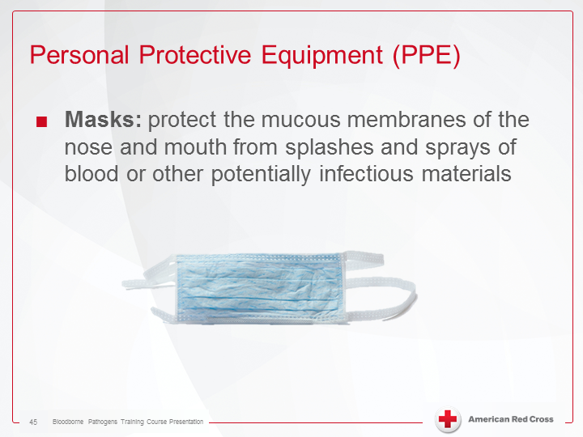
Personal Protective Equipment (PPE)
Notes:
Personal Protective Equipment (PPE)
Masks: protect the mucous membranes of the nose and mouth from splashes and sprays of blood or other potentially infectious materials

Slide 47
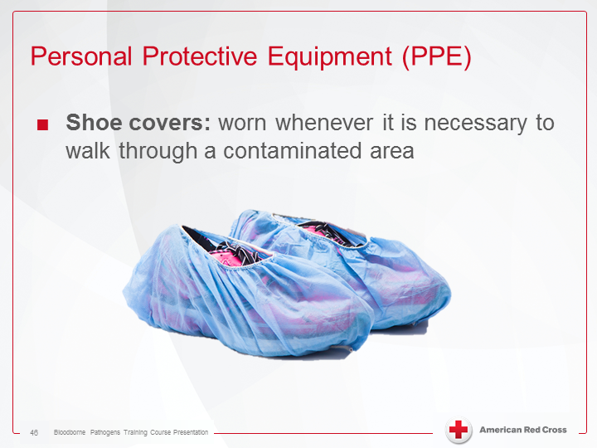
Personal Protective Equipment (PPE)
Notes:
Personal Protective Equipment (PPE)
Shoe covers: work whenever it is necessary to walk through a contaminated area

Slide 48
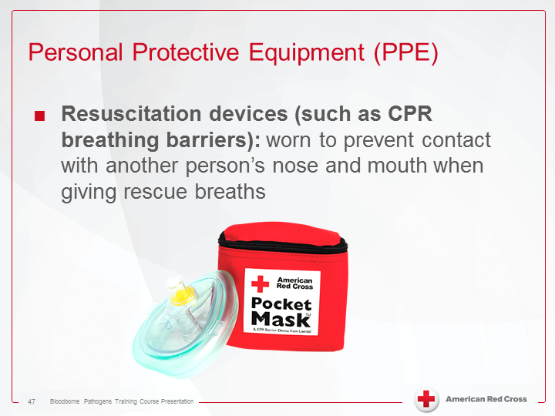
Personal Protective Equipment (PPE)
Notes:
Personal Protective Equipment (PPE)
Resuscitation devices (such as CPR breathing barriers): work to prevent contact with another person’s nose and mouth when giving rescue breaths

Slide 49
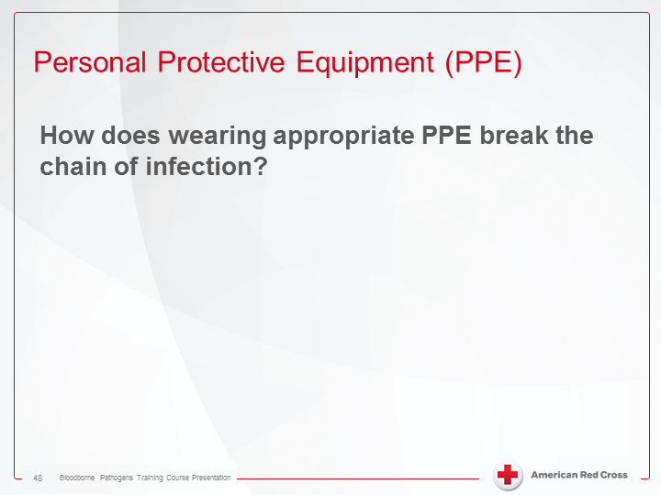
Personal Protective Equipment (PPE)
Notes:
Personal Protective Equipment (PPE)
How does wearing appropriate PPE break the chain of infection?

Slide 50
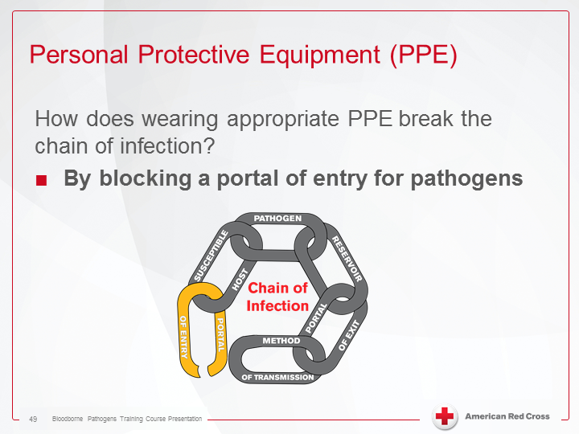
Personal Protective Equipment (PPE)
Notes:
Personal Protective Equipment (PPE)
How does wearing appropriate PPE break the chain of infection?
By blocking a portal of entry for pathogens

Slide 51
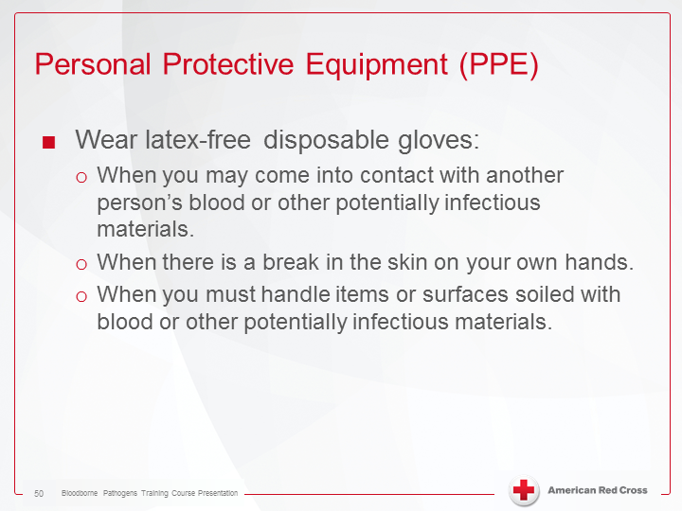
Personal Protective Equipment (PPE)
Notes:
Personal Protective Equipment (PPE)
Wear latex-free disposable gloves:
When you may come into contact with another person’s blood or other potentially infectious materials.
When there is a break in the skin on your own hands.
When you must handle items or surfaces soiled with blood or other potentially infectious materials.

Slide 52

Personal Protective Equipment (PPE)
Notes:
Personal Protective Equipment (PPE)
When you are wearing gloves, limit how much you touch other surfaces with your gloved hands.
Pathogens can transfer from the gloves to other items or surfaces that you though, putting the next person who handles the item or touches the surface at risk for infection.
When you are finished providing care, remove your gloves using proper technique, dispose of the gloves according to your employer’s policy and wash your hands.

Slide 53

Personal Protective Equipment (PPE)
Notes:
Personal Protective Equipment (PPE)
Gloves must be removed using proper technique so that you do not contaminate your own skin.

Slide 54


Personal Protective Equipment (PPE)
Notes:
Personal Protective Equipment (PPE).
Transcript:
Follow these steps to remove soiled gloves. First, pinch the palm side of one glove near the wrist and pull the glove off so that it is inside out. Holding the glove in the palm of your gloved hand, slip two fingers under the wrist of the glove, pull the glove off, inside out, so that the first glove that you removed is inside of it. Dispose of your soiled gloves properly and wash you hands.

Slide 55

Hand washing
Notes:
Hand Washing
Hand washing is the single most effective way to prevent the spread of infection.

Slide 56

Hand washing
Notes:
Hand Washing
How does washing hands break the chain of infection?

Slide 57

Hand washing
Notes:
Hand Washing
How does washing hands break the chain of infection?
By removing a method of transmission

Slide 58

Hand washing
Notes:
Hand Washing
At a minimum, wash your hands:
Before providing care (if possible), and always after providing care, even if you wore gloves.
After touching blood, other potentially infectious materials or broken skin.
After touching objects or surfaces that could be contaminated with blood or other potentially infectious materials.

Slide 59

Hand washing
Notes:
Hand Washing
At a minimum, wash your hands (continued):
After removing PPE.
Before and after eating or drinking.
After using the restroom.
To be effective, hand washing must be done using proper technique.

Slide 60

Hand washing
Notes:
Hand Washing.
Transcript:
To appropriately wash your hands, first, wet your hands and wrists under the running water. Keep your hands and wrists below the level of your elbow. Apply soap from the dispenser. Then, work your hands together to work up a lather. Wash vigorously for at least 20 seconds. Pay particular attention to the following areas – grasp, circle and wash each wrist with the opposite hand. Wash the palms and backs of your hands. Wash the areas between your fingers. Rub your nails against the palms of your hands to clean underneath them. Rinse your hands and wrists under the running water, keeping your hands lower than your elbows and your fingertips down. Using a clean, dry paper towel, dry your hands starting at the fingertips, moving back toward the elbow. Drying your hands thoroughly keeps them from becoming chapped. Discard the paper towel in a facility approved waste container. Use another clean, dry paper towel to turn off the faucet and discard the paper towel in a facility approved waste container. Use a clean paper towel to cover the handle before opening the door. If the door does not have a handle, push the door open with your hip and shoulder to exit. As an alternative to washing with soap and water, you may use an alcohol-based hand sanitizer. After using an alcohol-based hand sanitizer, wash your hands with soap and water as soon as possible.

Slide 61

Hand washing
Notes:
Hand Washing
How long should it take you to wash your hands properly?

Slide 62

Hand washing
Notes:
Hand Washing
How long should it take you to wash your hands properly?
At least 20 seconds

Slide 63

Hand washing
Notes:
Hand Washing
What areas should you be sure to clean while washing your hands?

Slide 64

Hand washing
Notes:
Hand Washing
What areas should you be sure to clean while washing your hands?
The palms and backs of the hands
In between the fingers
The wrists
Underneath the nails

Slide 65

Hand washing
Notes:
Hand Washing
An alcohol-based hand sanitizer can be used to decontaminate the hands if soap and water are not readily available.
Alcohol-based hand sanitizers may not be as effective if the hands are visibly soiled.

Slide 66

Hand washing
Notes:
Hand Washing
To use an alcohol-based hand sanitizer:
Dispense the recommended amount of product into your palm.
Rub your hands to cover all surfaces of both hands, including underneath the nails and between the fingers.
Continue rubbing the hands until the product dries.

Slide 67

Hand washing
Notes:
Hand Washing
Wash your hands with soap and water as soon as possible after using an alcohol-based hand sanitizer.
Alcohol-based hand sanitizers may not eliminate all types of pathogens.

Slide 68

Maintaining a safe environment
Notes:
Maintaining a Safe Environment
Disposable equipment and supplies need to be discarded properly to limit other’s risk of exposure.
Reusable equipment and surfaces that have been contaminated by blood or other potentially infectious materials need to be properly cleaned and disinfected.

Slide 69

Maintaining a safe environment
Notes:
Maintaining a Safe Environment
Always wear latex-free disposable gloves and other PPE as needed when cleaning equipment or surfaces or disposing of contaminated equipment or supplies.

Slide 70

Maintaining a safe environment
Notes:
Maintaining a Safe Environment
Place soiled items in labeled biohazard containers for disposal, cleaning or laundering according to the procedures in your employer’s exposure control plan.

Slide 71

Maintaining a safe environment
Notes:
Maintaining a Safe Environment
“Sharps”: objects contaminated with blood or other potentially infectious materials that could cause puncture wounds or lacerations, such as used needles or broken glass.

Slide 72

Maintaining a safe environment
Notes:
Maintaining a Safe Environment
Carefully dispose of sharps in a puncture-resistant sharps container immediately after using them to limit others’ risk for injury and exposure to bloodborne pathogens.

Slide 73

Maintaining a safe environment
Notes:
Maintaining a Safe Environment
Never recap a sharp object before disposing of it, because you could stick yourself while trying to replace the cap.
Never overfill an sharps container.
Never open, empty or reuse a sharps container.

Slide 74

Maintaining a safe environment
Notes:
Maintaining a Safe Environment
Never clean up broken glass using your hands.
Because trash bags may contain sharp objects, avoid packing trash bags down with your hands or swinging them near your legs when you walk.

Slide 75

Maintaining a safe environment
Notes:
Maintaining a Safe Environment
Spills of blood or other potentially infectious materials must be cleaned up promptly and properly to limit the potential for exposure to bloodborne pathogens.

Slide 76

Maintaining a safe environment
Notes:
Maintaining a Safe Environment
Cleaning up spills of blood or other potentially infectious materials is a two-step process.
First, the surface must be cleaned.
Then, the surface must be disinfected.

Slide 77


Maintaining a safe environment
Notes:
Maintaining a Safe Environment.
Transcript:
A spill of blood or other potentially infectious materials must be cleaned up promptly and properly. To protect yourself and others, follow these steps – first, block access to the area to protect others from potential exposure. Next, gather your cleaning supplies. Use the supplies specified in your employer’s exposure control plan. This might include, disposable tongs, disposable absorbent towels, a solidifier, disposable scoop and scraper, a biohazard bag, a biohazard sharps container, and 10% bleach water disinfectant solution. Then, put on the appropriate personal protective equipment according to your employer’s exposure control plan. You should always wear disposable, non-latex gloves when coming into contact with blood or other potentially infectious materials. You might also need a gown, shoe covers, eyewear, a mask or a face shield. Before cleaning up the spill, remove any sharp objects using tongs or a disposable scoop and scraper – never use your hands. Remember to dispose of the sharp object in a biohazard sharps container. Wipe up the spill using disposable absorbent towels. Dispose of the towels in a biohazard bag. If available, you can also use a solidifier to absorb the spill – just pour the powder onto the spill and scoop up the mix. Dispose of soiled materials in a biohazard container. Put on clean gloves. When using a bleach solution, always wear gloves and eye protection and ensure good ventilation. Then, flood the area with a disinfectant solution. Also, be sure to let the bleach solution stand on the surface for at least 10 minutes. Finally, use clean absorbent materials to wipe up the disinfectant solution and dry the area. Dispose of all soiled materials, including your personal protective equipment, in a biohazard bag.

Slide 78

Maintaining a safe environment
Notes:
Maintaining a Safe Environment
Scrub equipment, boots and leather goods using a brush and hot, soapy water.
Specific procedures for cleaning and disinfecting equipment and work clothes should be outlined in the exposure control plan.

Slide 79

If a exposure incident occurs
Notes:
If an Exposure Incident Occurs
An exposure incident occurs when:
A person’s blood or other potentially infectious material comes into contact with another person’s eyes, mouth or an opening or break in the skin.
A person experiences a needlestick injury.

Slide 80

If a exposure incident occurs
Notes:
If an Exposure Incident Occurs
In the event of an exposure incident, follow these steps immediately:
Decontaminate.
Notify the appropriate people.
Complete the necessary decontamination.
Seek follow-up care.

Slide 81

If a exposure incident occurs
Notes:
If an Exposure Incident Occurs
First, decontaminate the exposed area:
Wash needlestick injuries, cuts and contaminated skin thoroughly with soap and water.
If blood or another potentially infectious material splashes into your mouth or nose, flush the area with water.
If blood or another potentially infectious material splashes into your eyes, irrigate them with clean water, saline or a sterile irrigant for 15 to 20 minutes.

Slide 82

If a exposure incident occurs
Notes:
If an Exposure Incident Occurs
Report the incident to the appropriate person at your place of employment.
Complete the necessary documentation.
Incident report form
Sharps injury log
Seek immediate follow-up care per your employer’s exposure control plan.

Slide 83

Course wrap-up
Notes:
Course Wrap-Up
Bloodborne Pathogens Game of Chance Activity
True or False?
What would you do?
Show me
Sequence the steps
Short answer
Instructor wild card

Slide 84

Course wrap-up
Notes:
Course Wrap-Up
Thank you for participating in the Bloodborne Pathogens Training course.
Digital course completion certificate available by contacting EH&S
Email ehs@farmingdale.edu to make your course completion certificate request
Certificate valid for 1 year
Questions?

